Slide 1
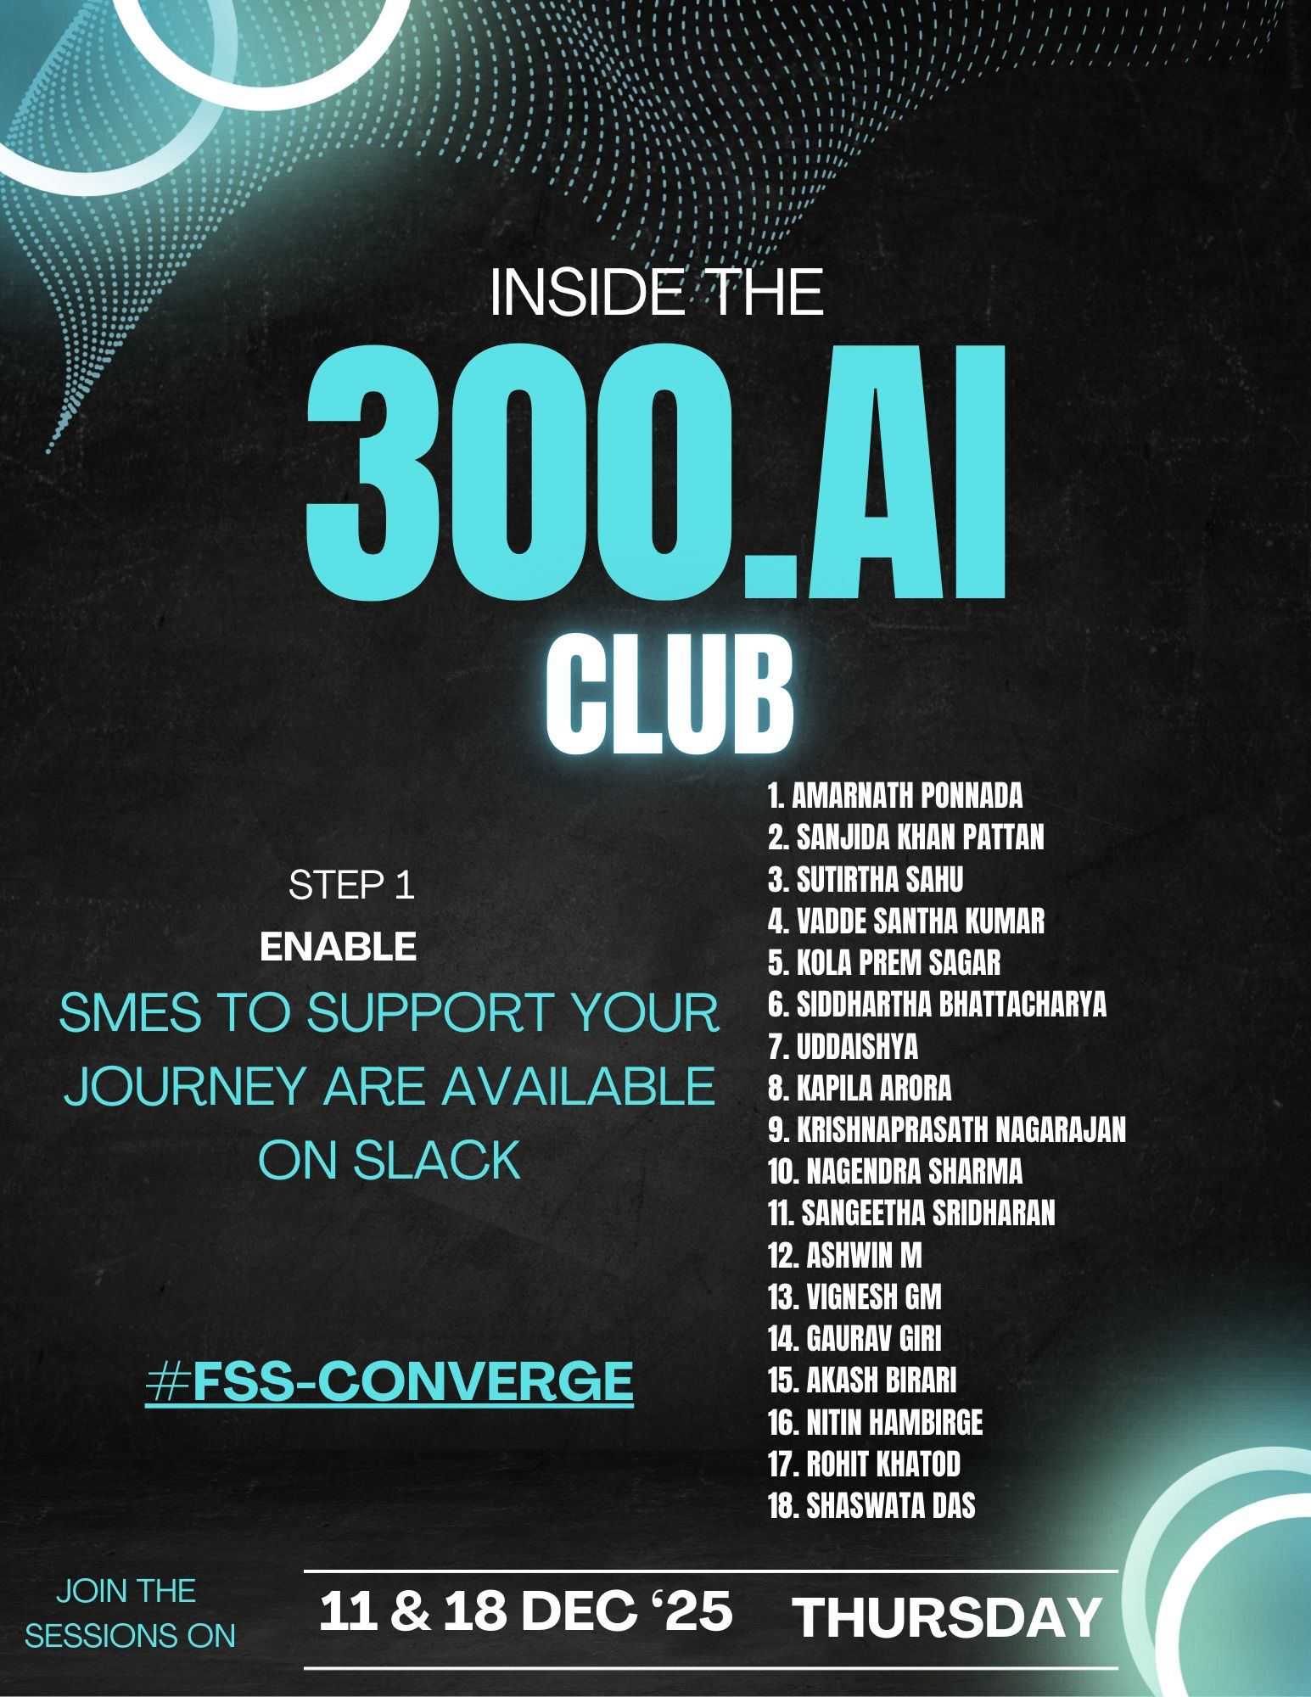
FSS 300.AI club Enablement Series

Slide 2

CIC FS – 300.AI Club
Objective: build a solid hands-on team of AI practitioners (Engineers and Architects) – commoditize AI development
Exec Sponsor: Anubhav Kothari
Exec Team: Surjit Das, Madhusudhan Deshmukh, Madhusmita Patil, Tanmay Ambre
Project Manager: Abhishek Randev
Communications: Mahua Banerjee
Journey
Enable
Gen AI
Agentic AI
Activate
Code Assistants
Design & Develop
Demonstrate
Showcase developed apps
Ideate
Engineering AI Apps
Agentic IDEs
Incorporate feedback
01 Dec 2025
31 Dec 2025
31 Dec 2026
Notes:
FSS Converge link & QR Code

Slide 3

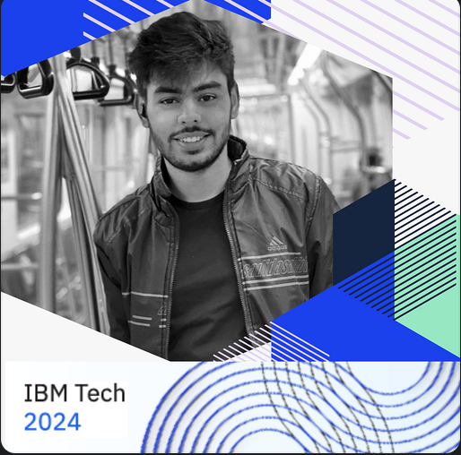

About Speakers
Siddhartha Bhattacharya
Executive Architect
Nationwide, Barclays
Uddaishya
GenAI innovator and Big Data developer at Barclays Account, Driving Agentic GenAI Solutions & Enterprise-Scale Automation
Model Context Protocol (MCP): The Universal Standard for GenAI Integration
Unlocking Efficiency: How Mixture of Experts Models Revolutionize Task Specialization
Krishnaprasath Nagarajan
Senior Full Stack Developer , GenAI –Python Developer at Barclays Account

Slide 4
Sidd’s Generative AI Journey
Learning themes
Tools & Techniques | Prompt Engg Assistant SDKs | RAG Function Calling | Fine Tuning IBM Tech & ICA | Agent Frameworks Multimodal Graph RAG | Agentic Orchestration MCP IBM R,T&C adoption | Memory & Context Mgmt Assistants & Spec Driven Dev
Integration & Governance | Traceability | APIs Databases | Evaluations Feedback Loop | Value Realization & Outcome Management | Enterprise AI and tool management policies Explainability, Auditability & Drift management
Deployment & Security |  | Local (Docker) | Performance Engineering | LLM and Agent Ops Agent Fallback | Data Governance & Synthetic Data Mgmt. Hyperscaler aligned deployment patterns
Agent Exploration
Conversational banking POV
Collaboration with Asset teams
ICA Hackathons
AWS Hackathons
MS Hackathons
Fine-tune model for BIAN
GenAI first modernization at scale framework
Early encounters
Assistant PoCs
Agentic Reference Architecture
Agent One for UK bank
GenAI IRB for Banking
8-member team
Socialization of Credentials with clients
Client demos
Modernization pilot at UK bank
GenAI Reference Architecture
Data Modernization and Migration engagements
Process Automation project
Present at client events
Patent Submission
Practice enablement
2023
2024
2025

Slide 5
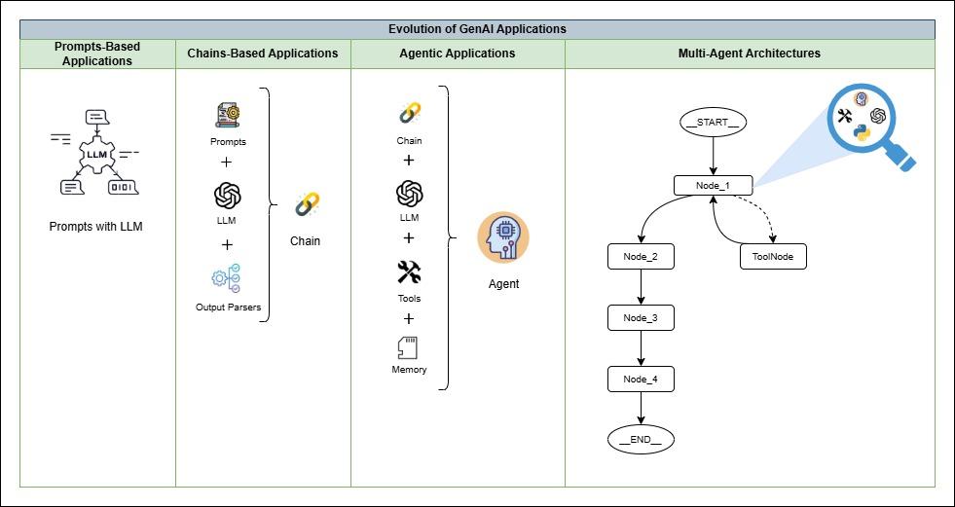
How did it all start?

Slide 6
Prompt Techniques & Prompt Template
Prompt Template
Technique | Examples/Description | Typical Use Case with Sample Example
Zero-Shot Prompting | No examples; direct instruction | General queries , summarization , Content Translation "Summarize this article in 100 words.”
Few-Shot Prompting | Multiple examples provided (N-shot) | Complex or nuanced tasks like Classification /Sentiment Analysis
Role-based Prompting | Assigns a persona or role to guide the response | "You are a senior data analyst..."
Chain-of-Thought Prompting | Encourages step-by-step reasoning | Problem-solving, math, logic "Explain your reasoning step-by-step to solve...”
A Prompt Template is reusable template , and plug in different inputs.
It helps you reuse the same structure, just by changing the input.
In prompts, it becomes: “Summarize the following text: {text}”
Prompt Template

Slide 7
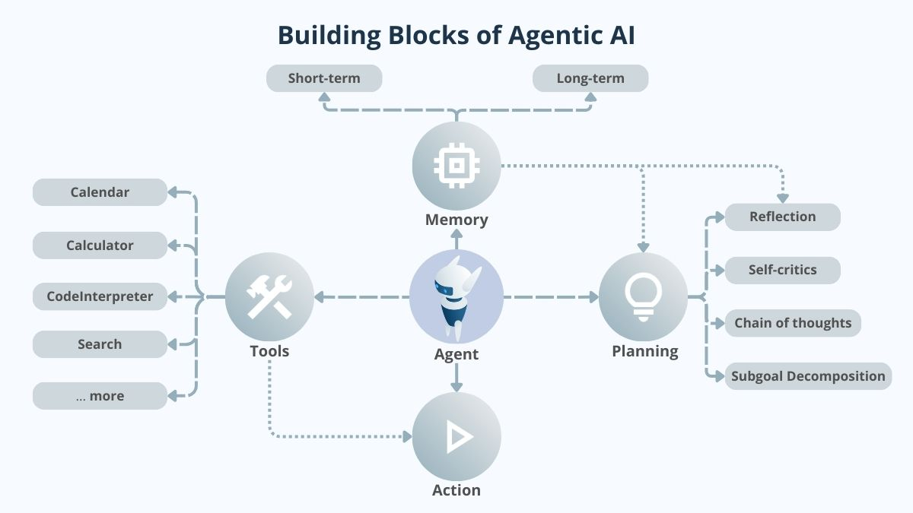
What is Agentic AI
Agentic AI refers to artificial intelligence systems that autonomously plan and execute tasks to achieve specific objectives, adapting to new information and environments with minimal human intervention.
Key Features :
Autonomous
Goal- Oriented Behaviour
Adaptive
Contextual Understanding
Proactive Actions

Slide 8
What powers Agentic AI
LLMs
Generative AI
Machine learning (ML)
Traditional programming
These AI systems, like OpenAI’s GPT models, are designed to understand and generate human-like text, forming the foundation for natural language processing and reasoning in agentic AI.
ML enables systems to learn from data and improve their performance over time. These algorithms handle pattern recognition and data-driven predictions, equipping agentic AI with adaptive intelligence.
Definition
Generative AI focuses on creating new content. In agentic AI, this capability fuels creativity and problem-solving by allowing systems to generate innovative solutions or simulate scenarios.
While advanced AI technologies handle learning and reasoning, traditional programming ensures that agents follow specific rules and constraints, providing structure and reliability in their autonomous operations.

Slide 9
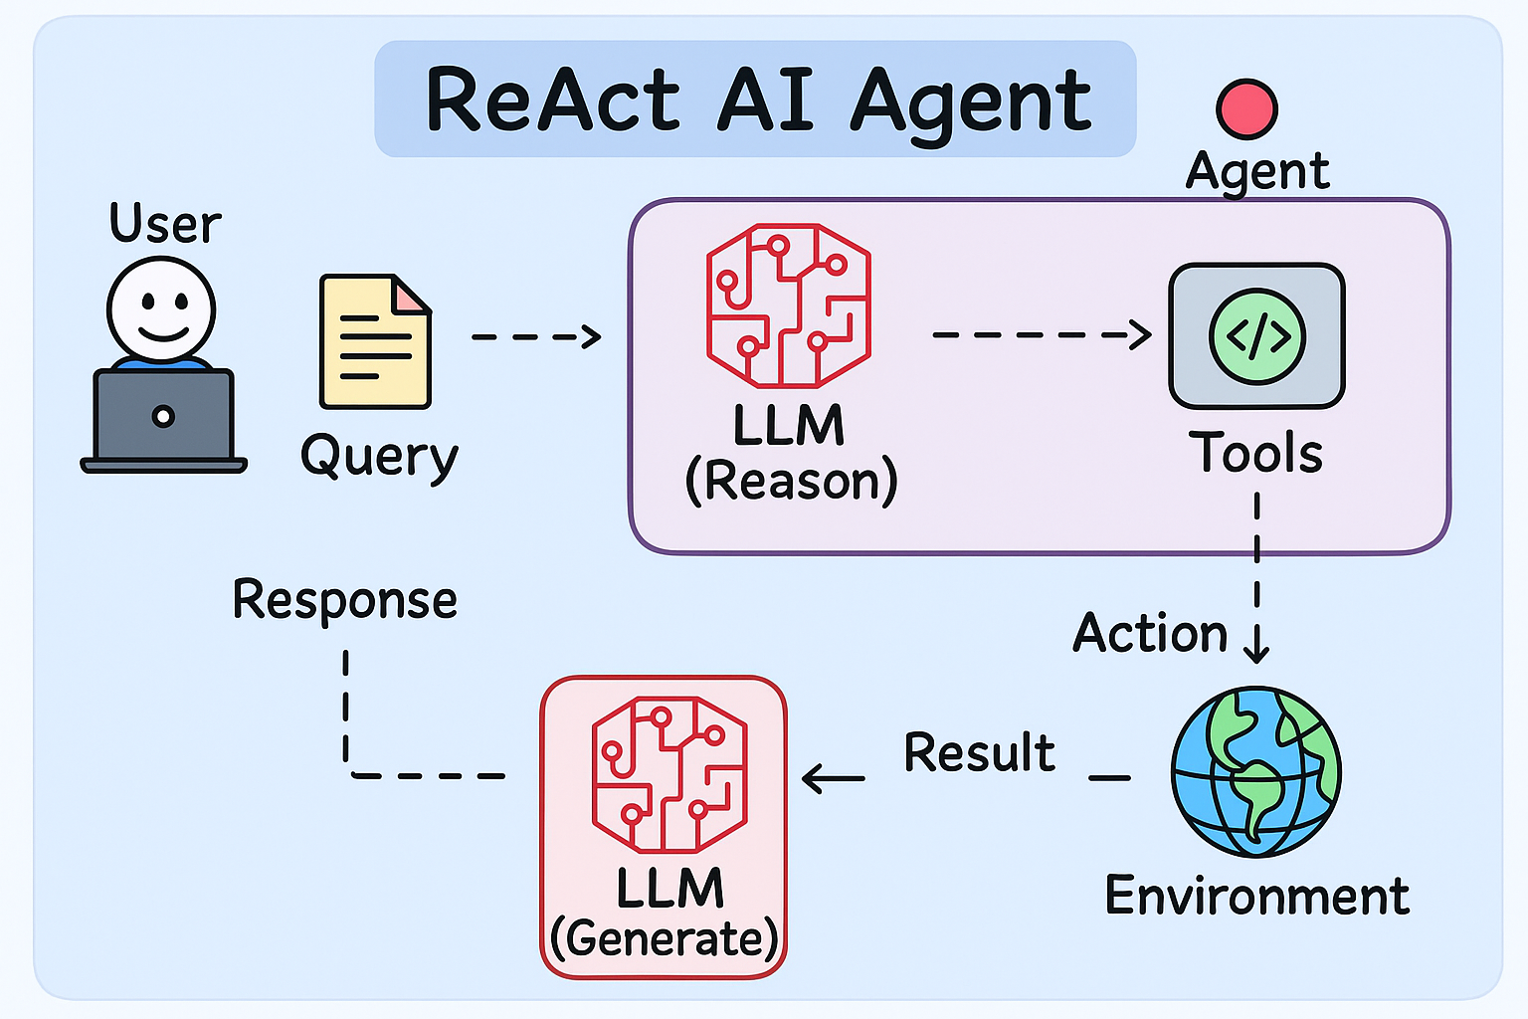
Let’s code our first Agent

Slide 10
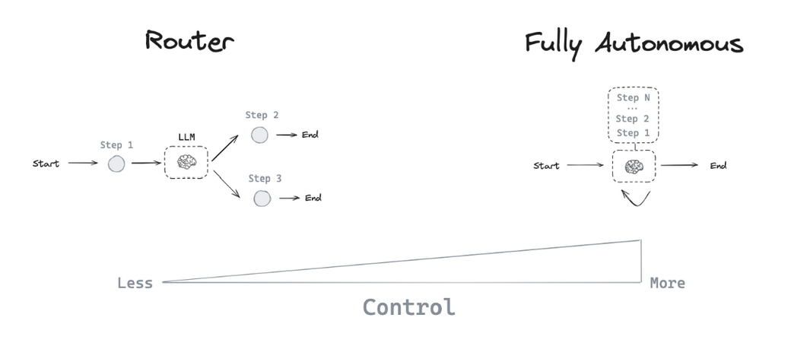
Agent architectures
Agent can decide the control flow of an application
LLM can control application in many ways:
An LLM can route between two potential paths
An LLM can decide which of many tools to call
An LLM can decide whether the generated answer is sufficient or more work is needed

Slide 11
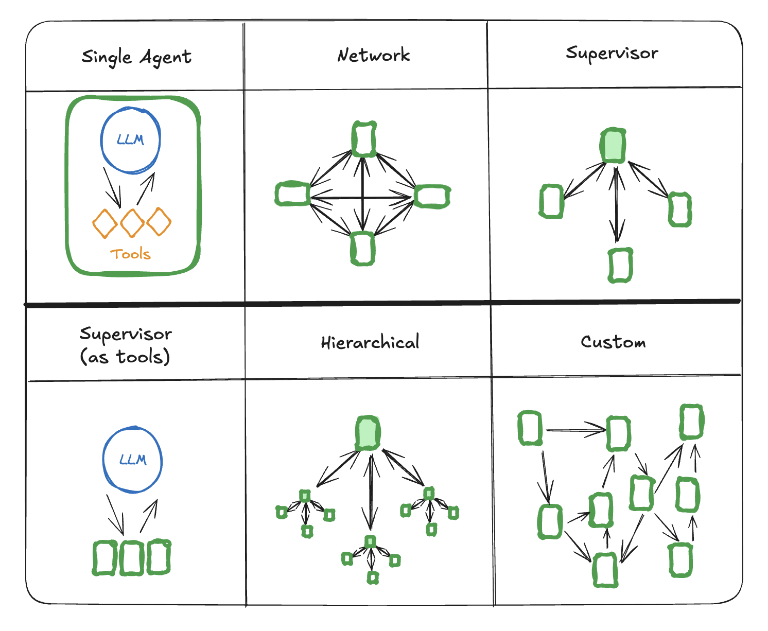
Multi-Agent architectures
Why do we need multiple agents ?
Can’t a single agent call multiple tools and get work done?

Slide 12
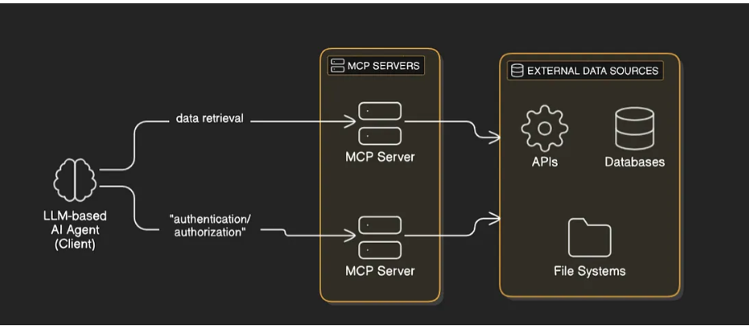
MCP
Model Context Protocol
What is MCP?
Open Standard
To Connect AI Agents with External Resources/tools/APIs
Unified & Scalable
Why do we need it?
providing a standardized protocol, making integrations easier, more robust, and scalable. Independent of any particular framework

Slide 13
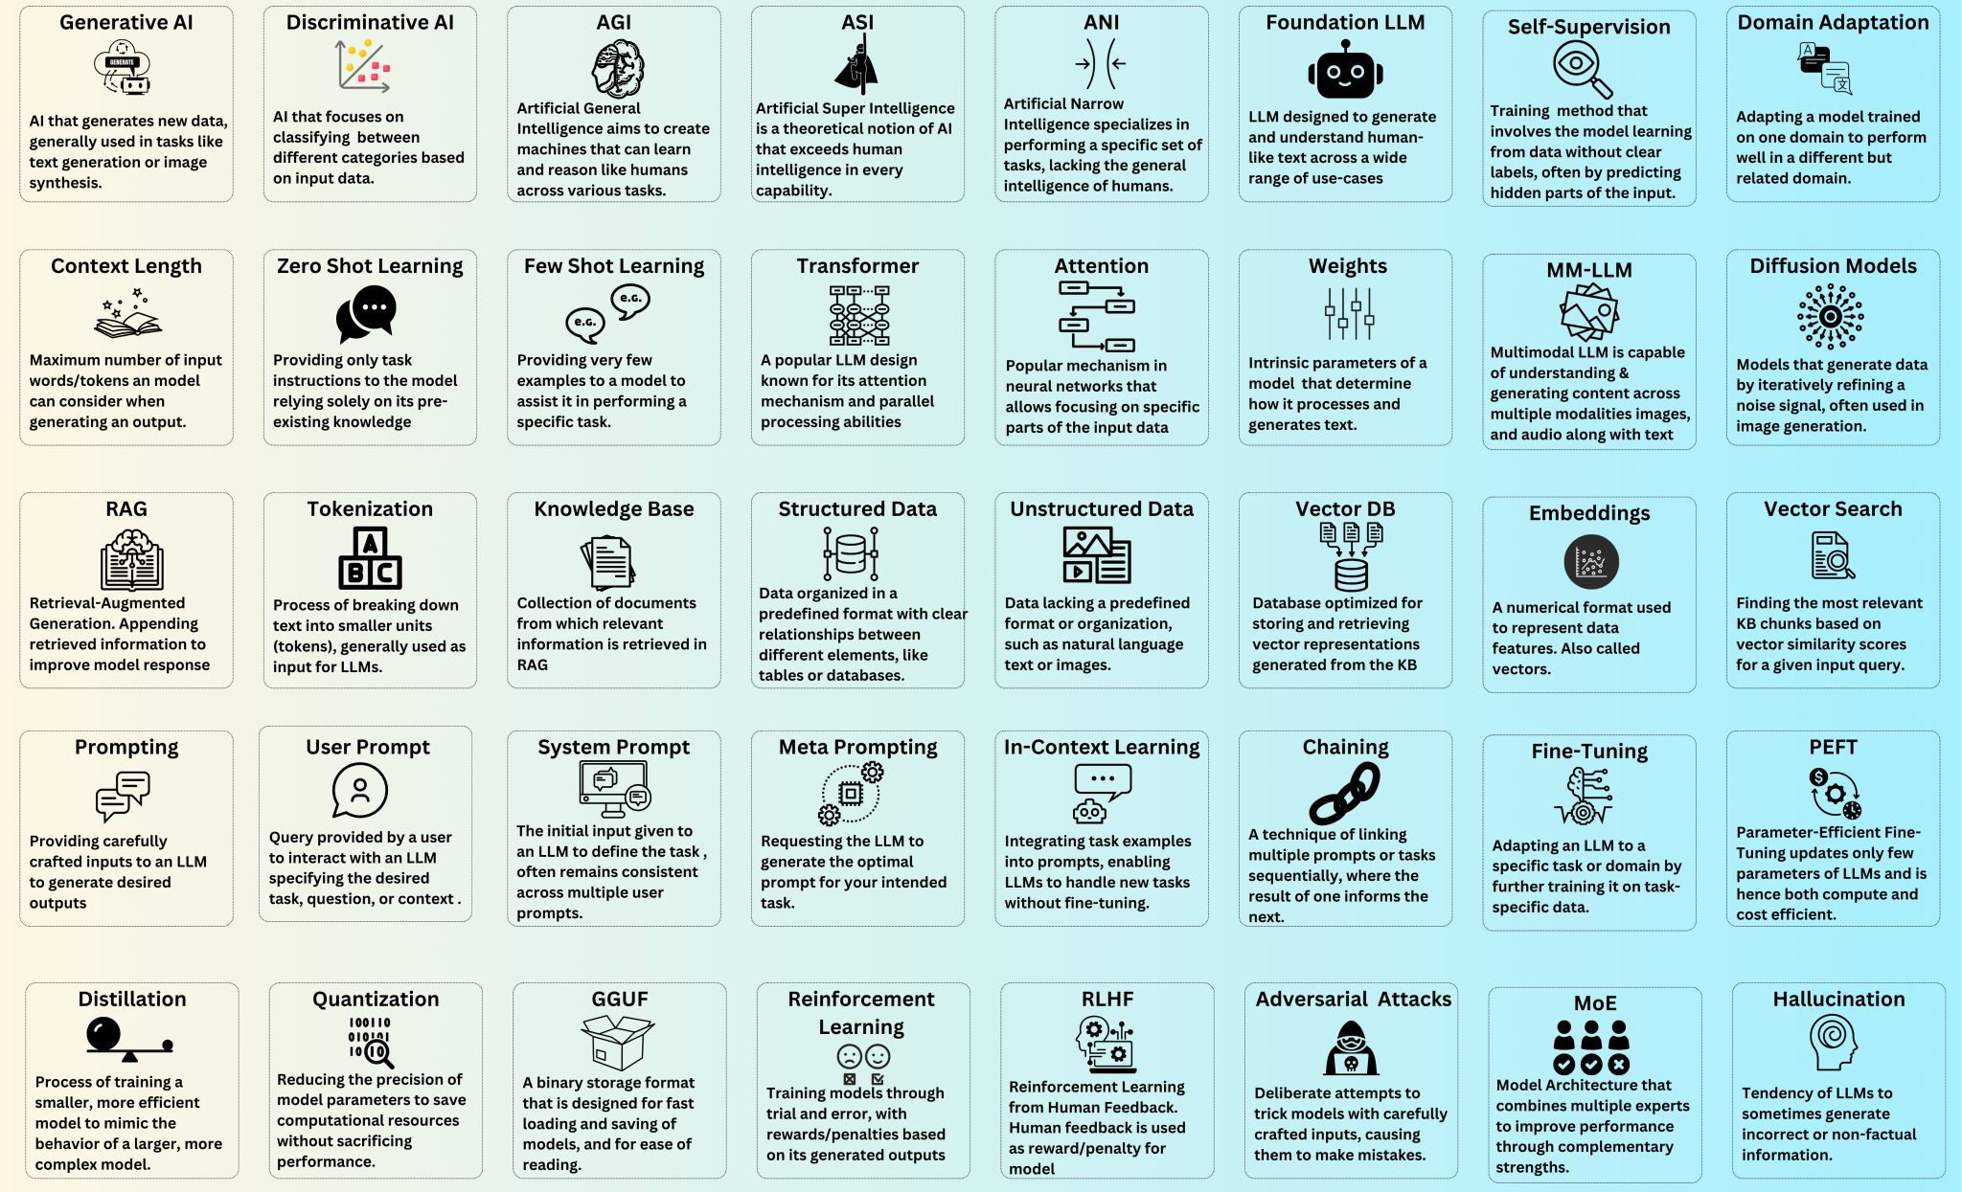
GenAI Lingo

Slide 14
Questions
FAQs
Kindly post your questions in #FSS-Converge slack channel
Learning RoadMap and resources are shared in email and slack
SME support is available post the sessions for questions

Slide 15
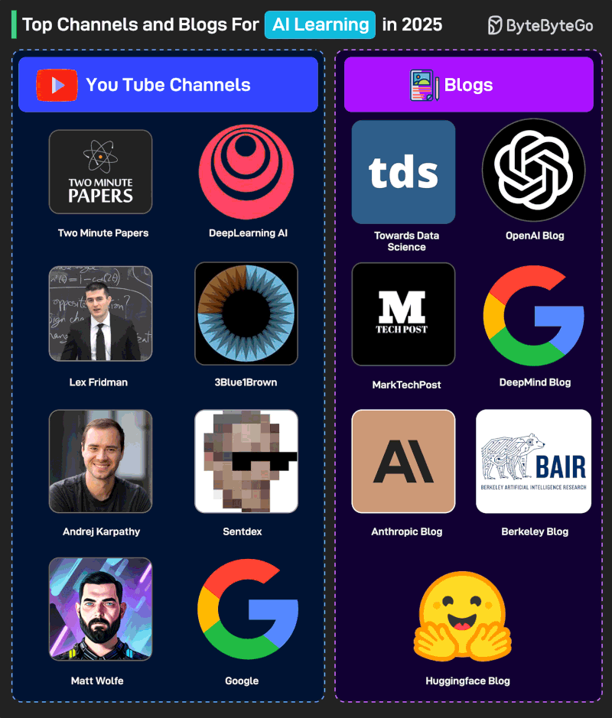
What Next?

Slide 16
1. Enablement: GenAI Learning Paths
General
Gen AI
Agentic AI
Developer Learning Path – General Awareness
Learn about the uses, impact, and underlying technologies of generative AI.
Course name | Link | Time | Prerequisites
Fundamentals of Generative AI | Course link (Your Learning) | 1 hour
Generative AI for Beginners | Course link (IBM-Udemy) | 3.5 hours
Ethics & Generative AI (GenAI) | Course link (IBM-Udemy) | 2 hours
Generative AI for Leaders & Business Professionals | Course link (IBM-Udemy) | 9.5 hour
The Complete Prompt Engineering for AI Bootcamp (2025) | Course link (IBM-Udemy) | 20 hours
Generative AI in Financial Services | Banking - Link (IBM-Think-topic) Insurance – Link – IBV Study | 1 hour
Note: Coursera courses are not free for IBM. However, you can access and learn using these courses, but you can’t access graded items (certificates and tests). Select option: “Audit Only” while enrolling. You will have access to all course materials except graded items.

Slide 17
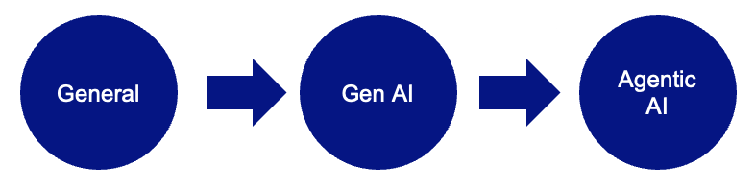
GenAI Learning Paths
Developer Learning Path – Gen AI
For developers who will be developing applications using Generative AI technologies
Course Name | Link | Time | Prerequisite
LangChain for LLM Application Development | Course link (deeplearning.ai) | 1 hour | Python
Functions, Tools and Agents with LangChain | Course link (deeplearning.ai) | 1 hour | Python
The Complete Prompt Engineering for AI Bootcamp (2025) | Course link (IBM-Udemy) | 24 hours | Python
Building and Evaluating Advanced RAG Applications | Course link (deeplearning.ai) | 1 hour | Python
Vector Databases: from Embeddings to Applications | Course link (deeplearning.ai) | 1 hour | Python
Understanding and Applying Text Embeddings | Course link (deeplearning.ai) | 1 hour | Python
Large Language Models with Semantic Search | Course link (deeplearning.ai) | 1 hour | Python
Evaluating and Debugging Generative AI Models Using Weights and Biases | Course link (deeplearning.ai) | 1 hour | Python
Quality and Safety for LLM Applications | Course link (deeplearning.ai) | 1 hour | Python
Finetuning Large Language Models | Course link (deeplearning.ai) | 1 hour | Python
Prompt Engineering (Handbook for Reference) | Handbook link |  | Python
LangChain- Develop LLM powered applications with LangChain | Course link (IBM-Udemy) | 7 hours | Python

Slide 18
1. Enablement: Agentic AI Learning Paths
Developer Learning Path – Agentic AI
For developers who will be developing applications using Generative AI and Agentic AI technologies
Course Name | Link | Time | Prerequisite | Role
DeepLearning.AI - Agentic AI | Course link (DeepLearning.AI) | 6 hours | Python | Data Scientist , AI Engineer
Generative AI for SDLC | Course link (DeepLearning.AI) | 3 hours | SDLC Process | SDE
AI Engineer Agentic Track: The Complete Agent & MCP Course | Course link (IBM-Udemy) | 8 hours | GenAI Fundamentals | AI Engineer
Agentic memory with LangGraph | Course link (DeepLearning.AI) | 1.5 hours |  | AI Engineer
GitHub Copilot - The Complete Guide | Course link (IBM-Udemy) | 5 hours |  | SDE
AI in software development | Reading Material | 30 Mins |  | SDE
IBM Consulting - FSS Agentic AI Enablement recorded series | Recorded Sessions (Box folder) | 7 hours | Python Basics | AI Engineer, Data Scientist
IBM Technology: AI Technical Tutorials | YouTube Playlist | - | Python | All roles
Watsonx Orchestrate Level 4 | Your Learning – Learning Path | 15 hours |  | All roles

Slide 19
Thank You

